Slide 1
Capstone Project
Retail Sales Prediction

Slide 2
Content
Wrangling the data
Dealing with Null Values
Converting PromoOpen and competitionOpen in a simplified way
Creating dummies for some columns
Checking distribution of data in SALES column, using Skewness
Checking distribution of different features, using Skewness
Finalising the data by Scaling
2. Implementing Regression techniques

Slide 3
Problem Statement
Sales on a particular day for different stores

Slide 4
Data Summary
Data set name – Retail Sales Prediction
- We have two datasets
- Stores having different features – “Store”
- Stores with sales on a particular day – “Rossmann Stores Data”
Shape of combined Dataset- 1017209 rows, 23 columns
Columns - 'Store', 'DayOfWeek', 'Date', 'Sales', 'Customers', 'Open', 'Promo', 'StateHoliday', 'SchoolHoliday', 'Year', 'Month', 'Day', 'Week', 'WeekOfYear', 'StoreType', 'Assortment', 'CompetitionDistance', 'CompetitionOpenSinceMonth', 'CompetitionOpenSinceYear', 'Promo2', 'Promo2SinceWeek', 'Promo2SinceYear', 'PromoInterval'

Slide 5
Cleaning dataset
We can see only a few columns had null values.
Column “CompetitionOpenSinceMonth” and “CompetitionOpenSinceYear” had null values – after exploring I got to know that I should replace the null by mode in this case.
Column “CompetitionDistance” had null values – after exploring I got to know that I should replace the null by median in this case.
Column “Promo2SinceWeek”, “Promo2SinceYear”, “PromoInterval” was having a lot of Null values, because those stores have not started any promotion, so they should be zero for our Dataset.
I have split the “Date” into Month, Year, week of year, day, and Week
Finally I have merged the two Datasets into one, named “df”
Other columns are already cleaned with no null values

Slide 6
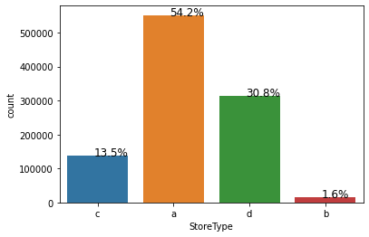
Stores
There are 4 different type of stores among which 54% stores are of type – a which is maximum, and the least is type - b

Slide 7
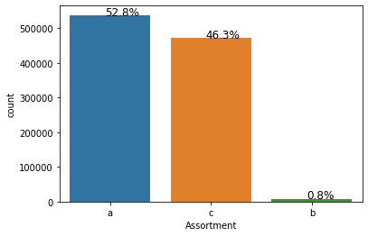
Stores with assortment level
There are 3 different type of assortment level among which 52% stores are of assortment type – a which is maximum, and the least is type - b

Slide 8
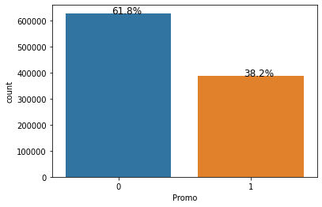
Stores
There are 1115 different stores among which 38% stores are running promo and 62% are not

Slide 9
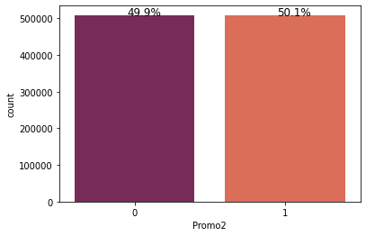
Stores
From these 38% i.e. 424 stores, 50% are having promo in continuation.
212 stores have started the 2nd onwards round

Slide 10
Average Sales by Store
Average Sales by store Type –a : 5738
Average Sales by store Type –b : 10058
Average Sales by store Type –c : 5723
Average Sales by store Type –d : 5641
So we can say maximum sales by store type “b”, but also the number of store with type “b” is minimum so we should consider type “a”

Slide 11
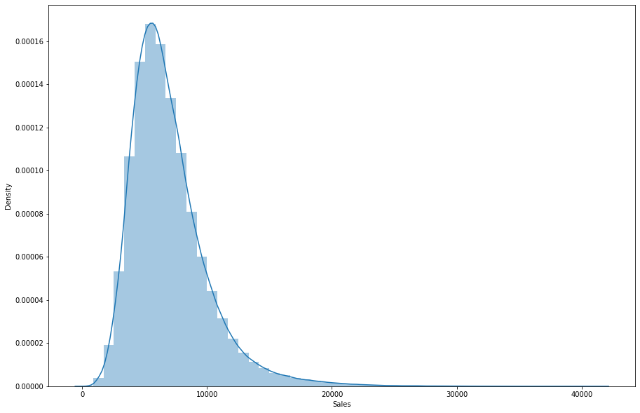
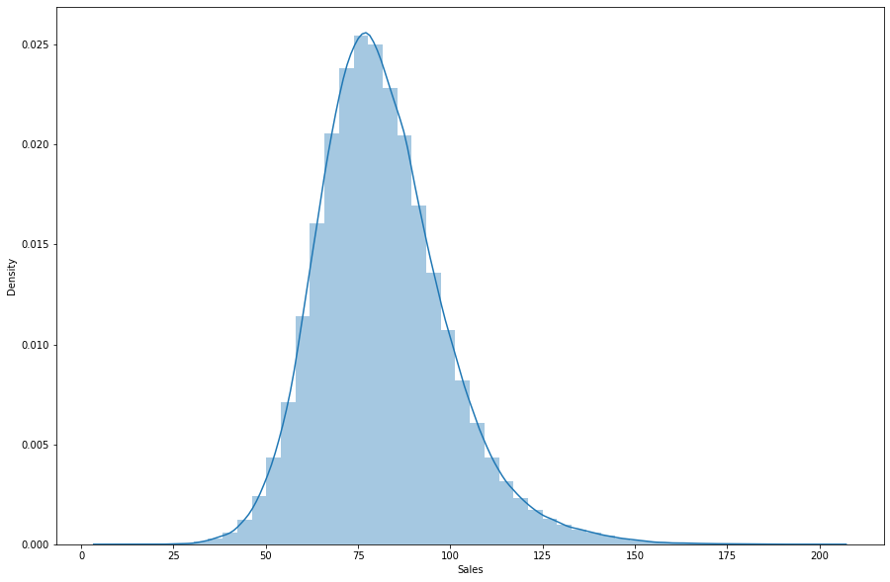
Sales distribution
Right skewed changes to approximately normal distribution using Sqrt

Slide 12
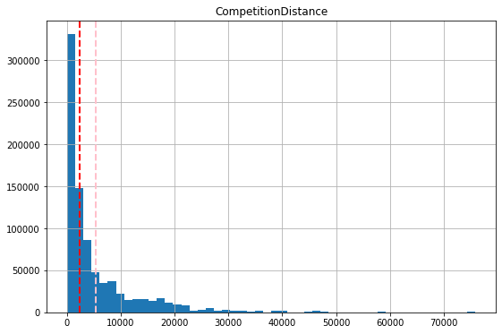
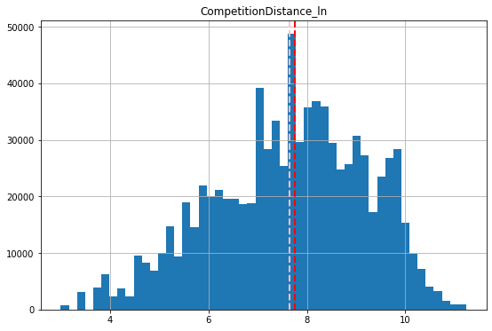
Distribution in independent features
Right skewed changes to approximately normal distribution using Sqrt

Slide 13
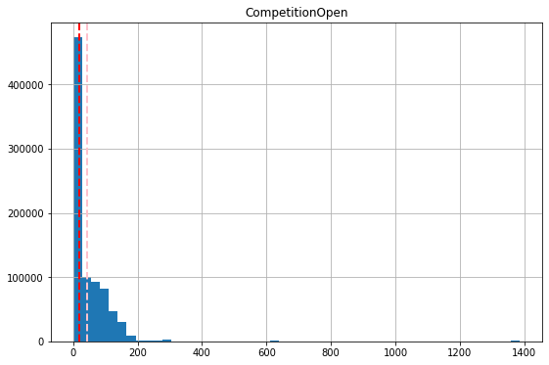
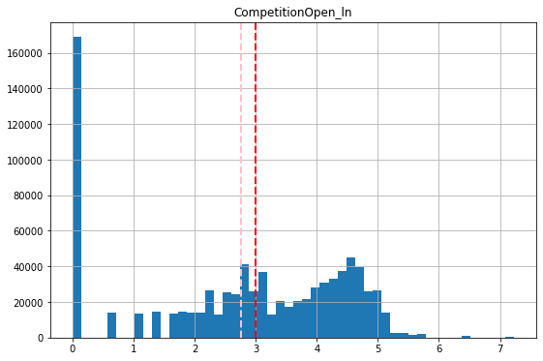
Distribution in independent features
Right skewed but after transformation changes to a bit left

Slide 14
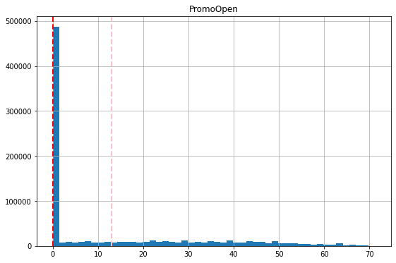
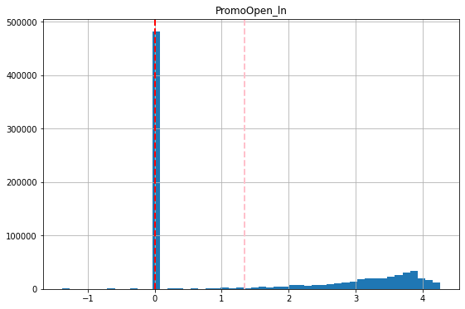
Distribution in independent features

Slide 15
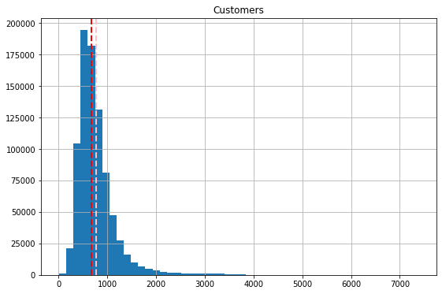
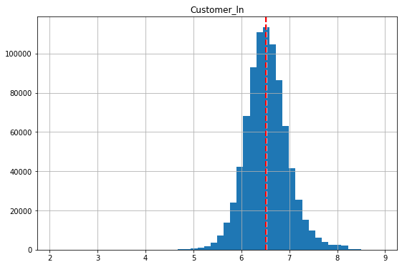
Distribution in independent features

Slide 16
Regressions
Accuracies by different algorithms:-
Linear Regression – 82%
Lasso – 73%
Decision Tree – 94.5%
Cross Validation with Decision Tree – 94.2%

Slide 17
Distribution in independent features

Slide 18
Conclusions
There are 4 different type of stores among which 54% stores are of type – a which is maximum, and the least is type – b
There are 1115 different stores among which 38% stores are running promo and 62% are not
we can say maximum sales by store type “b”, but also the number of store with type “b” is minimum so we should consider type “a”
From 212 stores, store number - 158, 277, 370, 612, 637, 808, 960 had run the promo for maximum number of months i.e. 71 months
Store number 815 has a competition from year 1900, so more than 100 years
We can make these PromoOpen negative values to zeros, because they have not started the promos at that time
Decision tree is the best for this dataset problem

